Slide 1
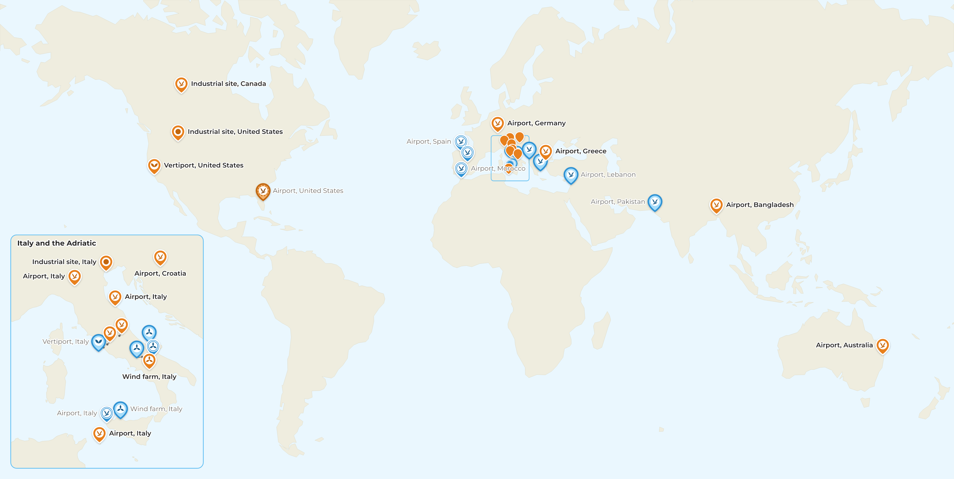




BCMS® VENTUR
BCMS® installations worldwide
STATUS
Installed
15
Installing
1
Contracted
5
Final discussion
8
PRODUCT LINE
VENTUR - aviation
VENTUR-E - wind and renewables
VENTUR-X - urban air mobility
Other
No client is named on this map. None has given written consent to be named on the web. Sites are labelled by sector and country.
15 installed in 8 countries. 14 more in the pipeline: being installed, contracted or in final discussion.
Provisional: status from the tEC site register, not yet confirmed in the CRM
The Edge Company
2026-09-11

